Slide 1
INSIGHTVISTA 2026
Adani Ports Nifty
Stock market analysis and visual insights, 2007 to 2021
Data Analytics And Visualisation
Subject Code: 1 IT508
GROUP: ALGO ALLIANCE
240840116001
240840116026
240840116045
240840116081
Enrollment numbers

Slide 2
STEP 1 | UNDERSTANDING THE RAW DATA
Raw data observation and problems found
3,322
13+ yrs
1
2
daily records
27 Nov 2007 to 30 Apr 2021
series (EQ), one stock
ticker names in one file
Problems identified
Symbol changed mid-series
The stock traded as MUNDRAPORT until Jan 2012 (1,023 rows), then ADANIPORTS. Grouping by symbol splits one history in two.
Prices not split-adjusted
694 rows (Nov 2007 to Sep 2010) sit at 5x the later price level, so a corporate action looks like a false price crash.
1
2
Missing trade counts
866 rows (up to May 2011) have no number of trades, which breaks averages and trend charts.
Raw values only, no analytics
No returns, moving averages or volatility. Turnover is in raw rupees (billions), which is hard to read.
3
4
Unusual trading days
14 records fall on weekends (special sessions) and extreme moves such as +20% and -19% need to be flagged, not deleted.
5
Notes:
Problems were identified from the traces left in the cleaned file (original symbol column, adjusted vs unadjusted prices, imputation flag).

Slide 3
STEP 2 | BUILDING THE FINAL CSV
Data cleaning and pre-processing
1
2
3
4
5
Parse and sort
Unify symbol
Adjust for split
Fix missing values
Engineer features
›
›
›
›
Convert Date to datetime, sort oldest to newest, check for duplicate dates (none found).
Keep the old name in Symbol_Original and use ADANIPORTS in Symbol for the whole history.
Create Adj_ price columns and Adj_Volume so 2007-2010 matches the current price scale.
Impute Trades and flag every filled row in Trades_Imputed (866 rows).
Add returns, range %, gap %, SMA 20/50/200, 20-day volatility, cumulative return and Trend.
Final output
3,322
42
0
ADANIPORTS_cleaned.csv
Saved with pandas: df.to_csv("ADANIPORTS_cleaned.csv", index=False)
rows
columns
missing values

Slide 4
STEP 3 | RESULT
Final clean dataset: how it solves the problems
Problem | Fix in the final dataset | Result
Two ticker names | Symbol + Symbol_Original columns | One continuous history
Unadjusted prices | Adj_Open / High / Low / Close / VWAP, Adj_Volume | Correct long-term trend
Missing Trades | Imputed values + Trades_Imputed flag | No gaps, still traceable
No analytics | Daily_Return_Pct, Range_Pct, Gap_Pct, SMA, Volatility_20D, Trend | Ready for analysis
Hard-to-read turnover | Turnover_Cr (crore) next to Turnover_INR | Readable scale
Column groups (42)
Date and calendar
Date, Year, Quarter, Month, Weekday
Price and volume
Raw and Adj_ OHLC, VWAP, Volume
Participation
Trades, Deliverable_Volume, Pct_Deliverable
Derived metrics
Returns, range, gap, SMA, volatility, Trend
Output: 3,322 trading days, one clean ticker, no missing values. Every dashboard chart is built from this file.

Slide 5
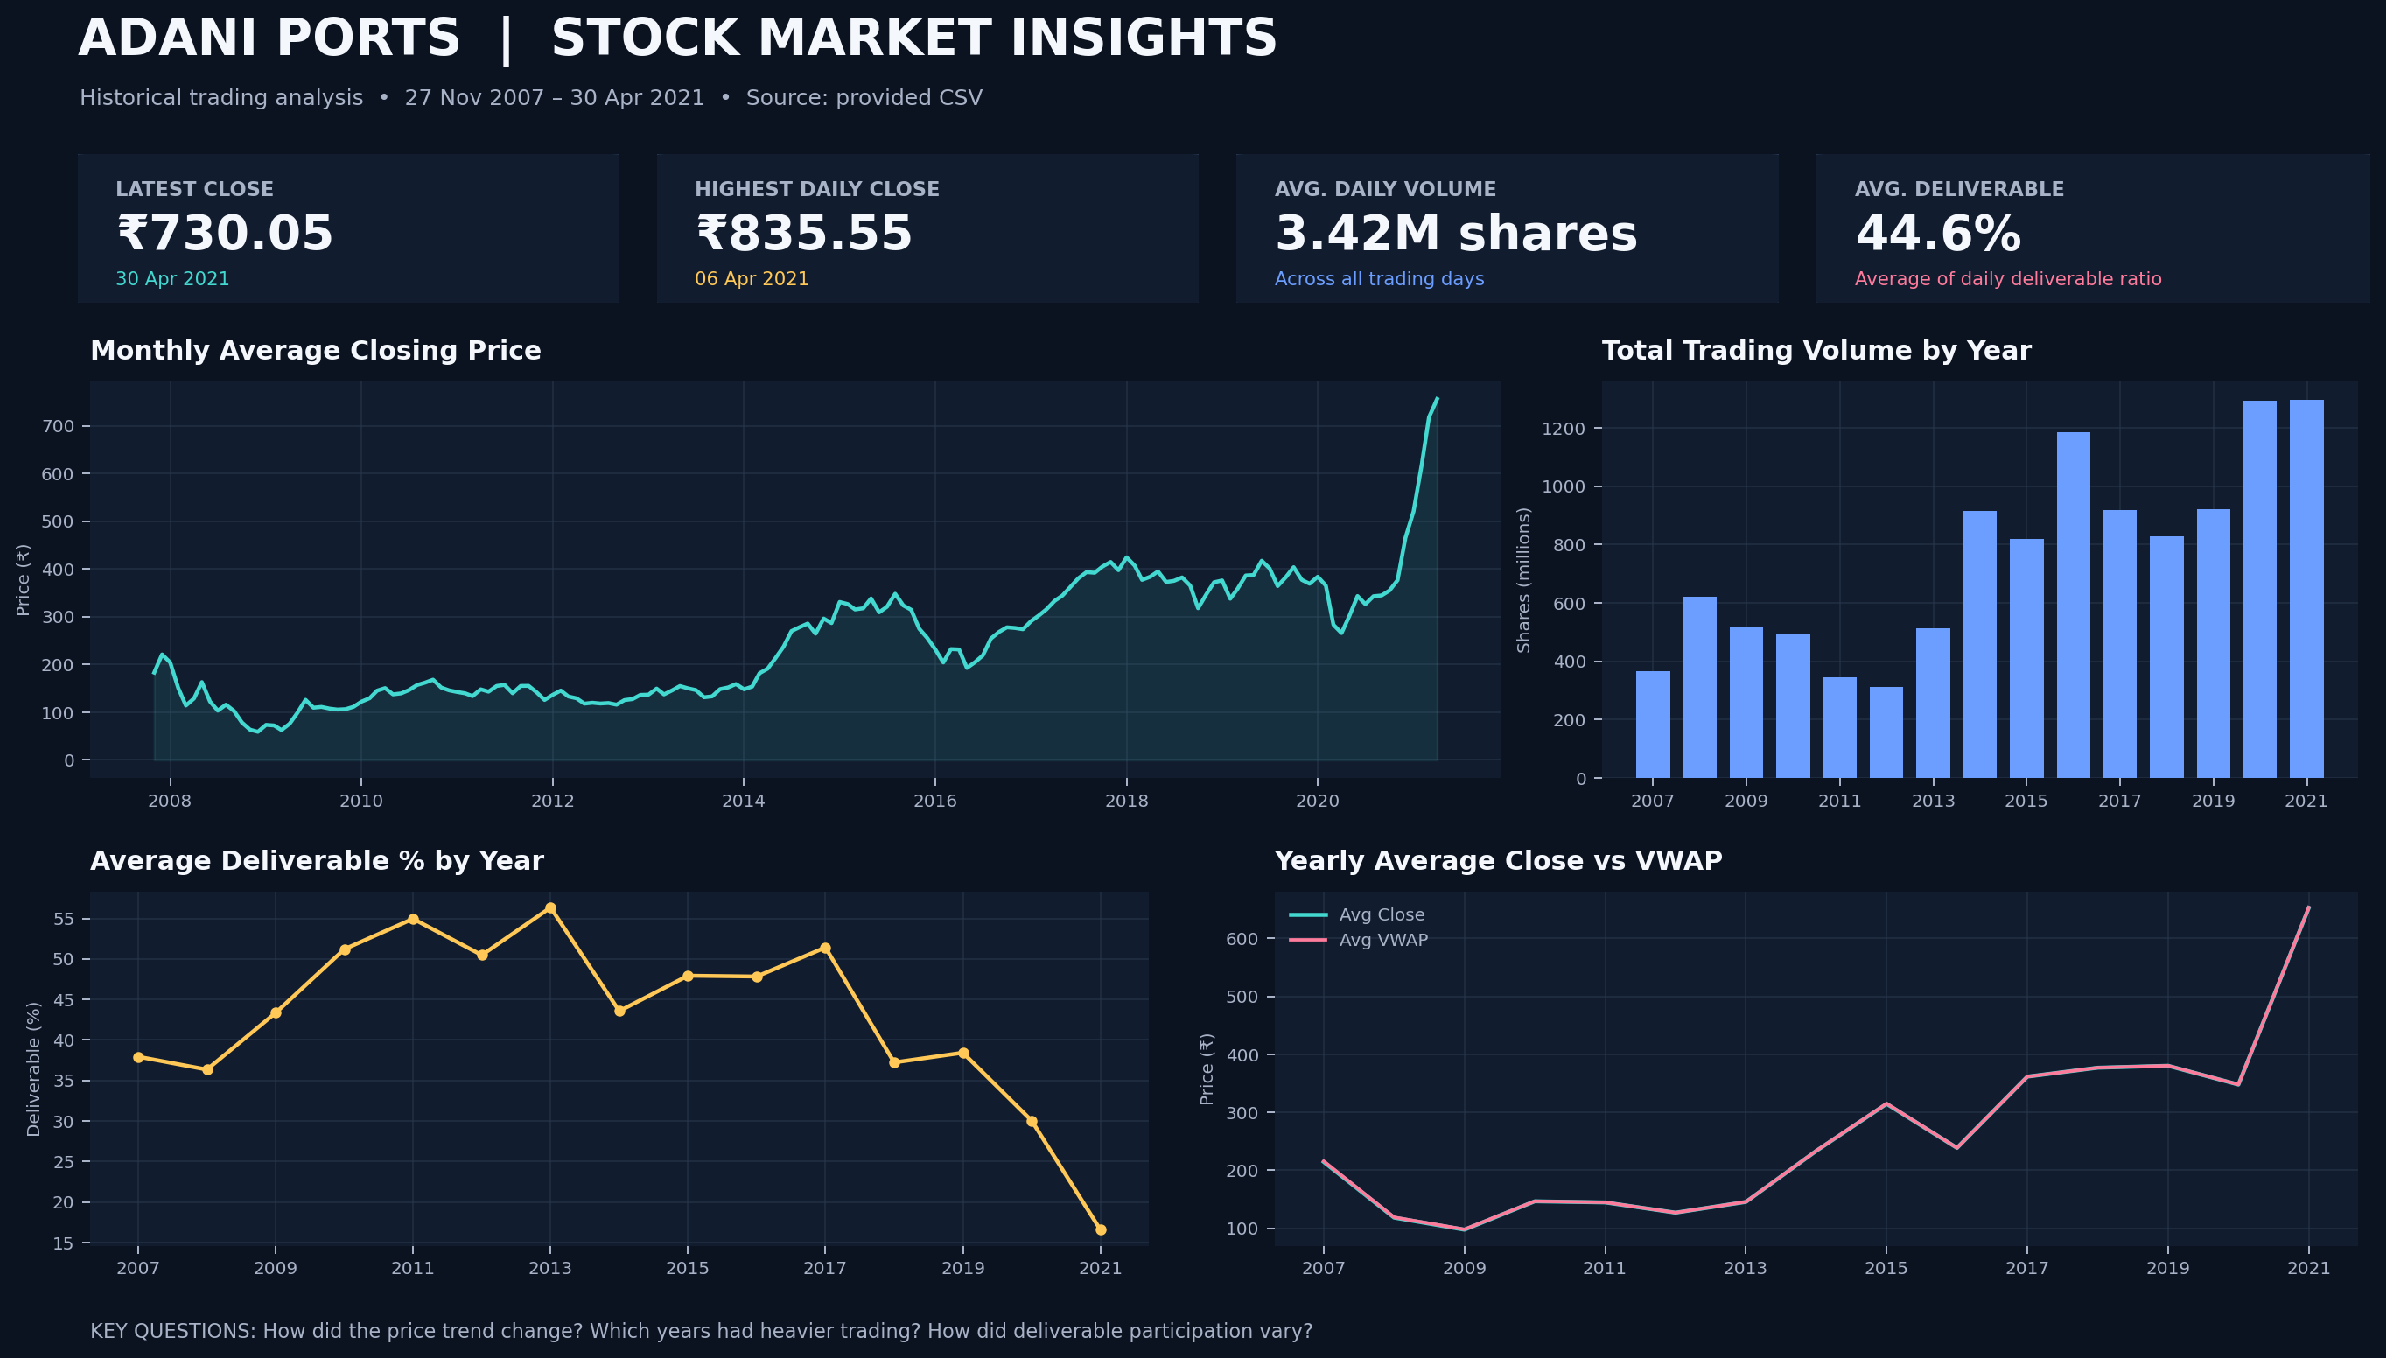
Visualised dashboard
DASHBOARD

Slide 6
DASHBOARD INSIGHTS
Observations and insights from the dashboard
Rs 730.05
Rs 835.55
3.42M
44.6%
Latest close, 30 Apr 2021
Highest close, 6 Apr 2021
Average daily volume
Average deliverable
Price trend
Trading volume
Prices fell to about Rs 52 in Nov 2008 (global crisis), moved sideways near Rs 100-150 until 2013, rallied from 2014, and surged in 2021. The 2021 average close of about Rs 653 is nearly double 2020 (about Rs 348).
Heaviest years were 2020 and 2021 (about 1.29 billion shares each; 2021 covers only four months), then 2016 (about 1.19 billion). Volume was lowest in 2011-2012.
Deliverable participation
Close vs VWAP and risk
Delivery share peaked at about 56% in 2013 and fell steadily to about 17% in 2021, so the recent rally is driven more by short-term trading than by holders.
Yearly Close and VWAP almost overlap, so closes are close to fair traded value. Biggest daily moves: +20% on 9 Jul 2008 and -19% on 23 Mar 2020.

Slide 7
WHAT TO DO NEXT
Recommendations
Always use adjusted prices
Raw 2007-2010 prices are on a different scale. Any model or chart must use the Adj_ columns.
1
Watch deliverable % with price
Falling delivery during a price surge signals speculative momentum. Track both before reading a rally as strong.
2
Plan for volatility
Daily swings reached +20% and -19%. Use the 20-day volatility and SMA 50/200 trend lines to size risk.
3
Add context to the analysis
Compare with the Nifty 50 index and peer port stocks, and add fundamentals such as cargo volumes and earnings.
4
Refresh and forecast
Keep the pipeline reusable for new data, then test forecasting models (ARIMA, LSTM) on the adjusted series.
5
For academic analysis only; not investment advice.

